Slide 1
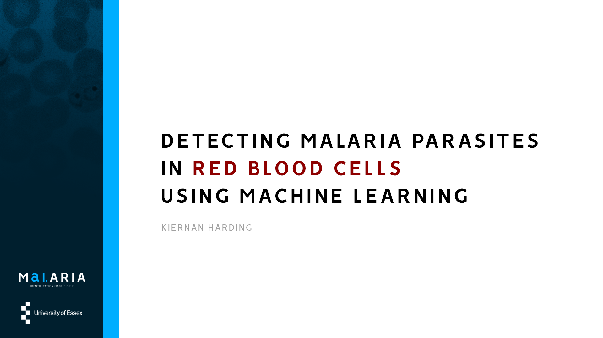
DETECTING MALARIA IN RED BLOOD CELLS USING MACHINE LEARNING
KIERNAN HARDING

Slide 2

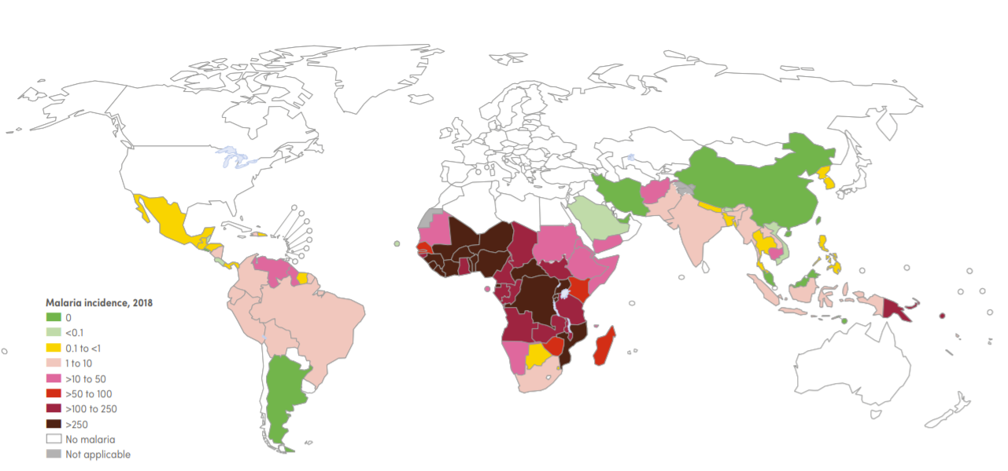
THE PROBLEM
Malaria has a major impact on global health
2019: estimated 229 million cases worldwide & 409,000 deaths [1]
Only 5 countries account for more than 50% of all cases [1]
Nigeria accounts for 27% of all cases [2] and has 34% of the world average GDP (per Capita) [3]
Poor quality testing in less developed countries
Map of malaria case incidence rate (cases per 1000 population at risk) by country (2018) [2]

Slide 3
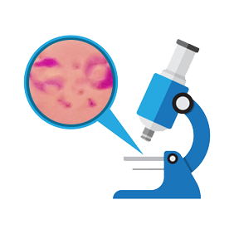
WHY TEST USING AI?
Yearly, hundreds of millions of blood films are examined by a trained microscopist
Microscopy involves manual counting of parasites in red blood cells
Timely
Costly
Microscopists in less economically developed areas have poor-quality control settings and little resources
RDT test accuracy (among under 5’s in 2015) is 79% [4]
Testing worrying low in children – only 30% (e.g. Nigeria) [2]
Lead to incorrect diagnosis
False positives and false negatives
Faster testing
Reduced workload
More accurate

Slide 4
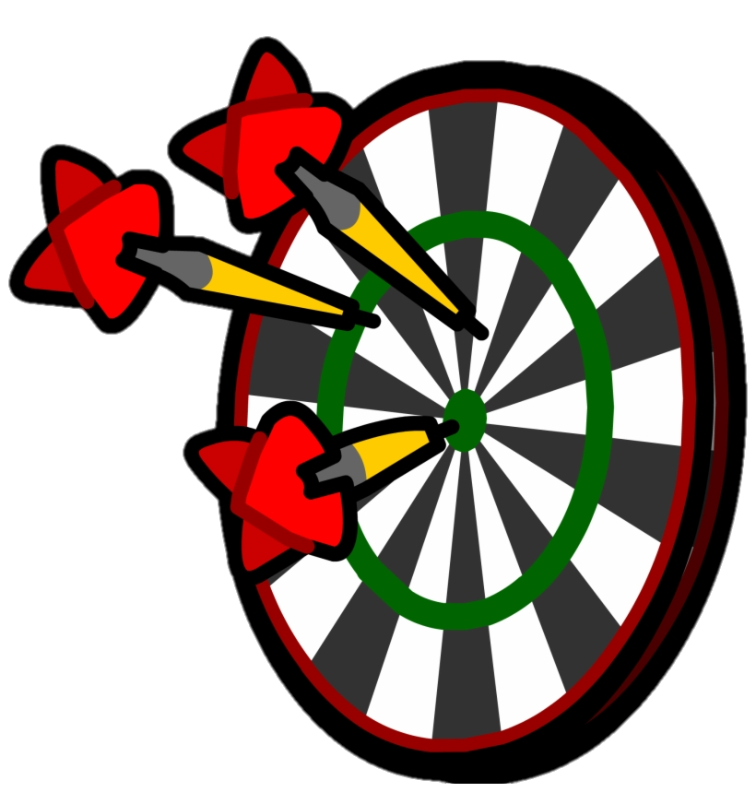
SUMMARISED AIMS & OBJECTIVES
Design and implement a classification tool that identifies malaria parasites in pre-segmented red blood cells
Design a Convolutional Neural Network using reputable Python ML libraries
Through iterative testing, improve CNN model performance (accuracy) using ML techniques
When testing the application on unseen samples, the model should achieve a higher test accuracy than the RDT’s diagnostic accuracy of 79% (among under 5’s in Nigeria, 2015 [4])
Create a classification tool that is accessible via almost any device, enabling its use in less developed counties
The application should be simplistic to allow easy use for individuals with limited medical knowledge

Slide 5

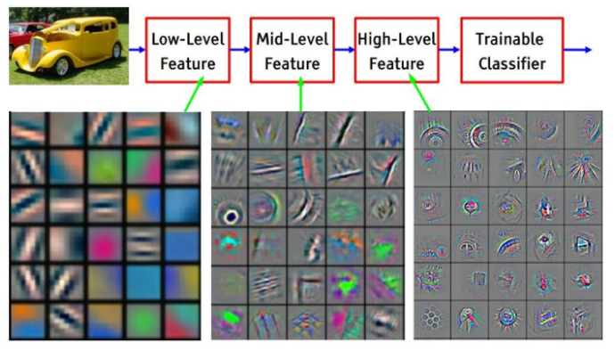
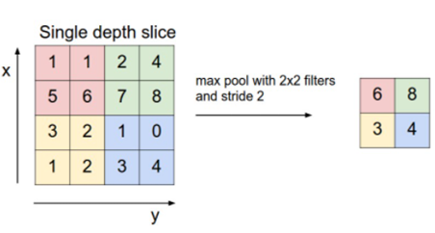
WHAT IS A CNN?
Short for ‘Convolutional Neural Network’
Class of deep learning neural networks
Learns similarly to a child - inspired by the human brain
Trained through backpropagation:
Forward pass - pass input data through network as normal as caches values
Backwards pass - go back through network and alter loss (similar to telling a child they’re incorrect, which they then learn from)
Different types of layers:
Convolutional – identifies features in images, such as straight lines and curves, aids learning process (becoming less abstract over time)
Activation function (e.g. ReLU) – aids the network to learn complex patterns in the data - increase non-linearity (ReLU: returns 0 if negative and value x if positive)
Pooling (e.g. max pooling) – reduces sample size and thus speeds up processing
Fully connected – essentially the output layer (provides probabilistic values)
Convolution [5]
Convolved feature maps [6]
Max pooling [7]

Slide 6
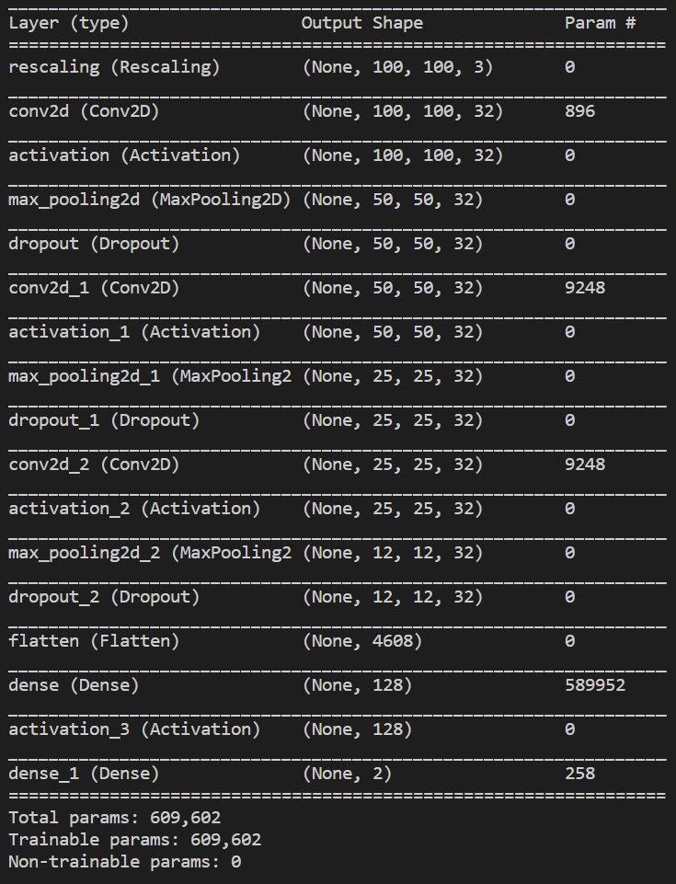
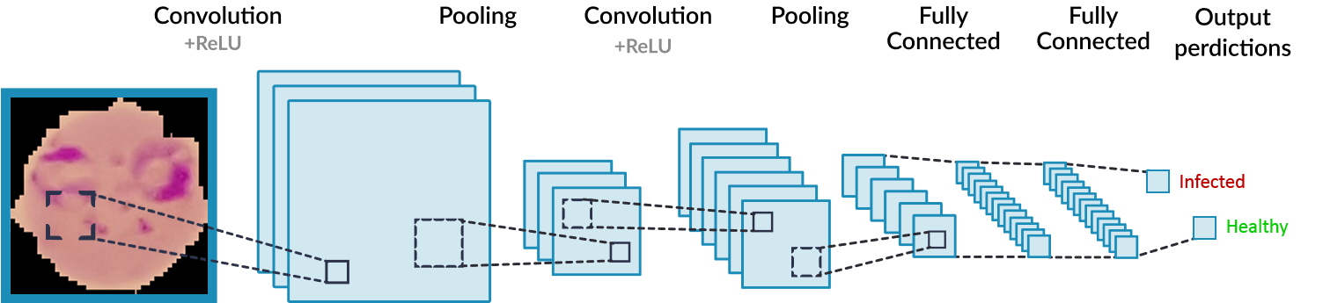
CREATING A CNN MODEL
Final model architecture
Splitting the dataset into training, validation and testing (~80/10/10)
Preparing the dataset for training – rescaling
Created a convolutional neural network model in Python using TensorFlow and Keras
3 main layers and an output layer (the fully connected layer)
These layers include: convolutional, activation (ReLU), pooling and fully connected
Greyscale, colour…
Example CNN model architecture

Slide 7

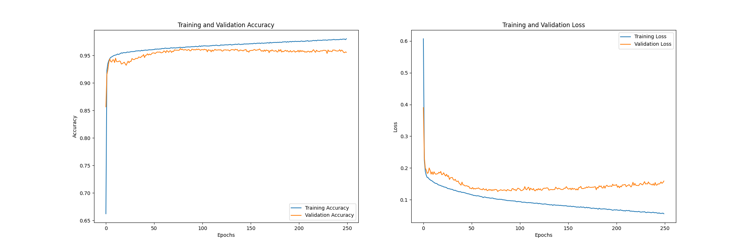
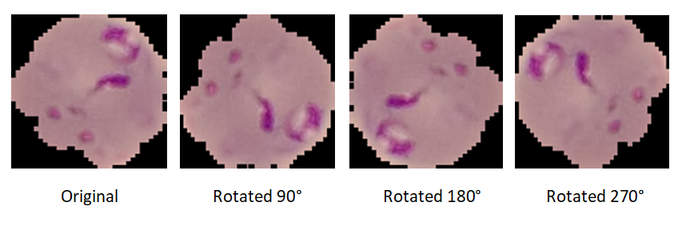
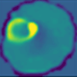
IMPROVING PERFORMANCE
Iteratively improved performance by evaluating a current model’s validation accuracy
Machine learning techniques to reduce overfitting and improve model performance:
Data Visualisation
Different perspectives, easy comparisons
Data Augmentation
Rotate, flipping, translation, scaling…
Regularisation
Applying dropout
Optimizer Adjustment
Adam, SGD, RMSprop
Feature Map Visualisation
Identify key areas that are detected
Dropout representation [8]
Final CNN model training graph
Feature map sample
Data augmentation

Slide 8
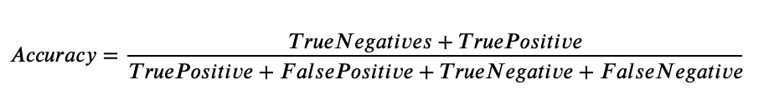
EVALUATION/MILESTONE RESULTS
I evaluated the performance by calculating the model accuracy
I iteratively improved on my model performance
The model achieves a higher test accuracy than the RDT’s diagnostic accuracy of 79% (among under 5’s in Nigeria, 2015 [4])
NIH only achieved ~2% higher accuracy in a similar project
Accuracy equation [9]
Model | Validation Accuracy | Test Accuracy
Greyscale (Interim) | 94.2% | 71.4%
Initial Colour | 93.6% | 93.3%
Colour Model (Final) | 96.2% | 95.6%

Slide 9





UI - WEB APPLICATION
Use of web development to increase the applications accessibility in remote areas (localhost)
No specific requirements (e.g. android application = limits reach)
Uses the Flask library to implement the Keras CNN model into a web application
Bootstrap styling…
Simple to use and navigate
Takes an image input of a blood sample
Classifies and outputs whether the sample is infected

Slide 10
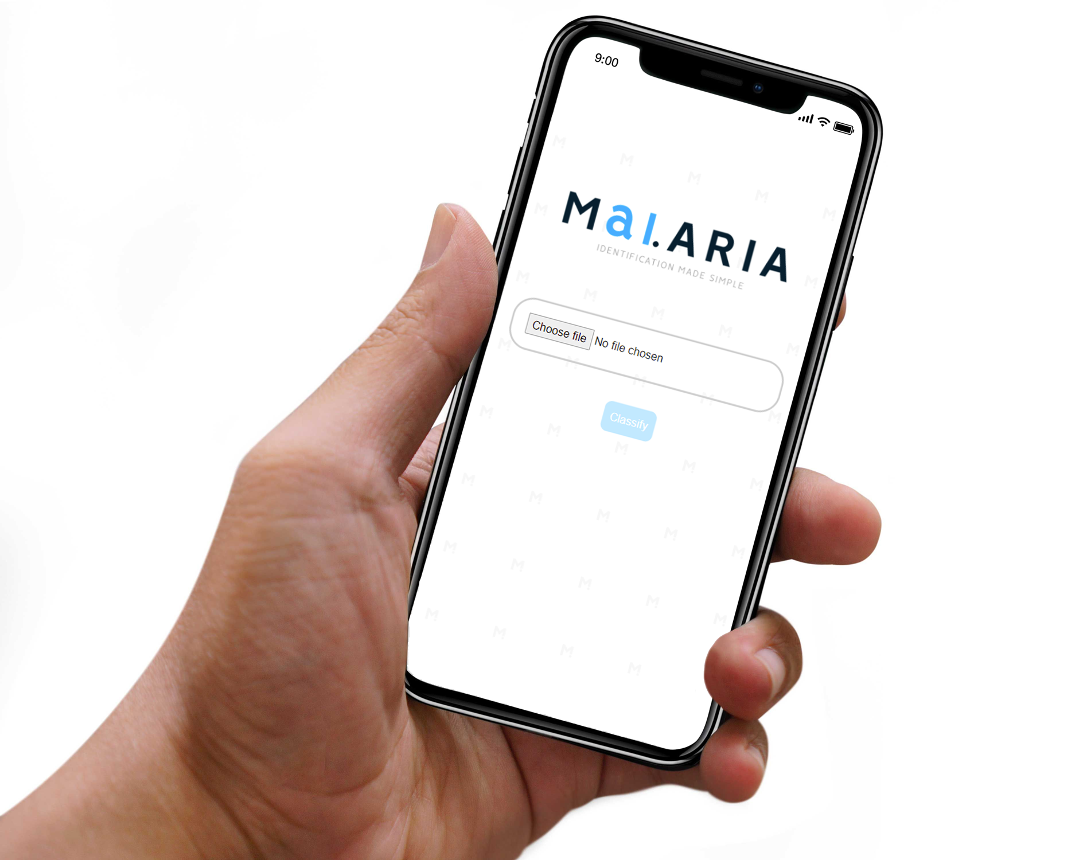
DEMO
A web application that includes a back-end machine learning classifying model
Can be used on any device with an internet browser
Live examples of infected blood cells being classified
Live examples of healthy blood cells being classified

Slide 11
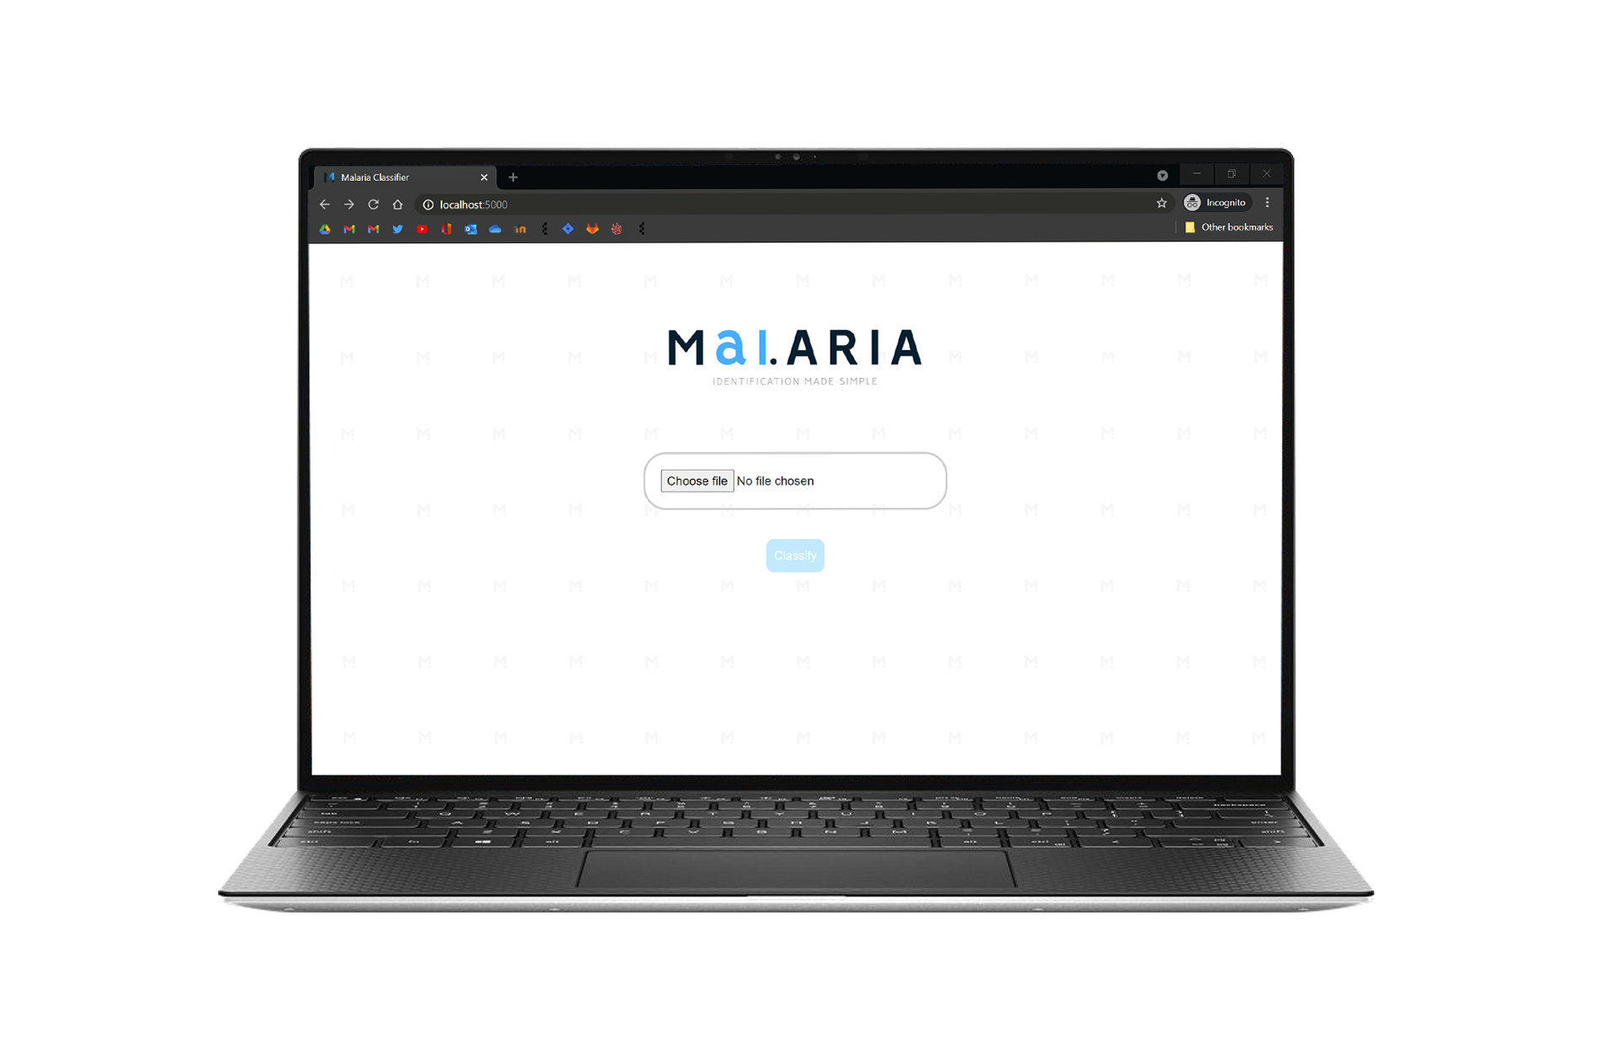
DEMO
1. The home page

Slide 12
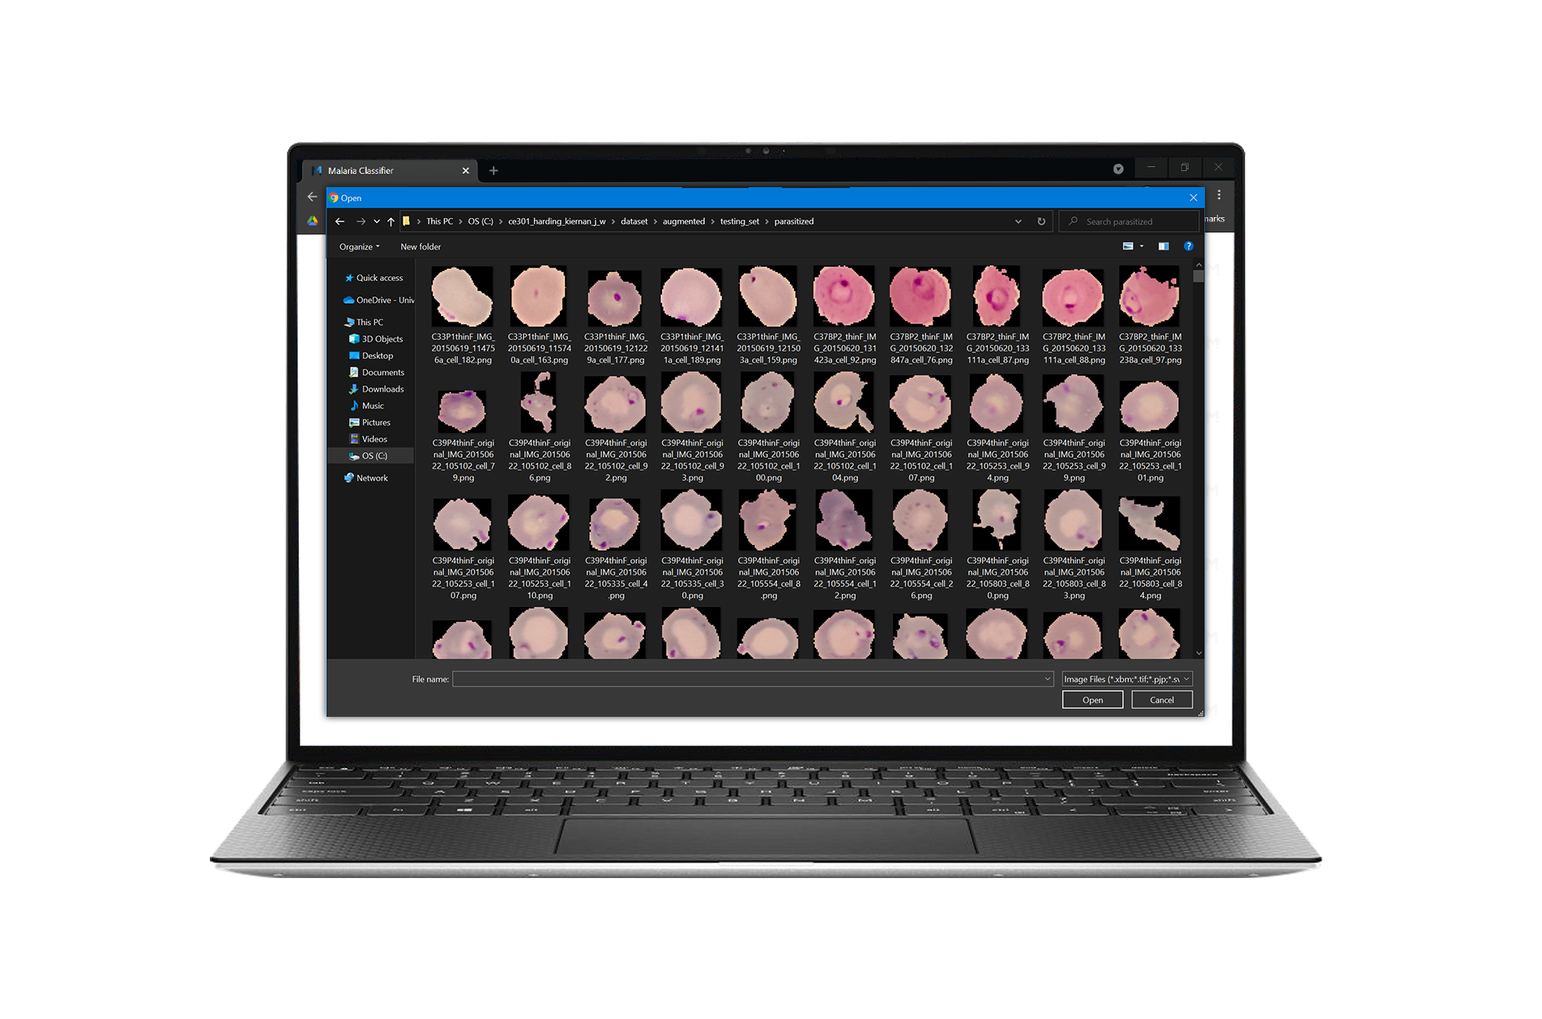
DEMO
2. Choosing the pre-segmented red blood cell to classify

Slide 13
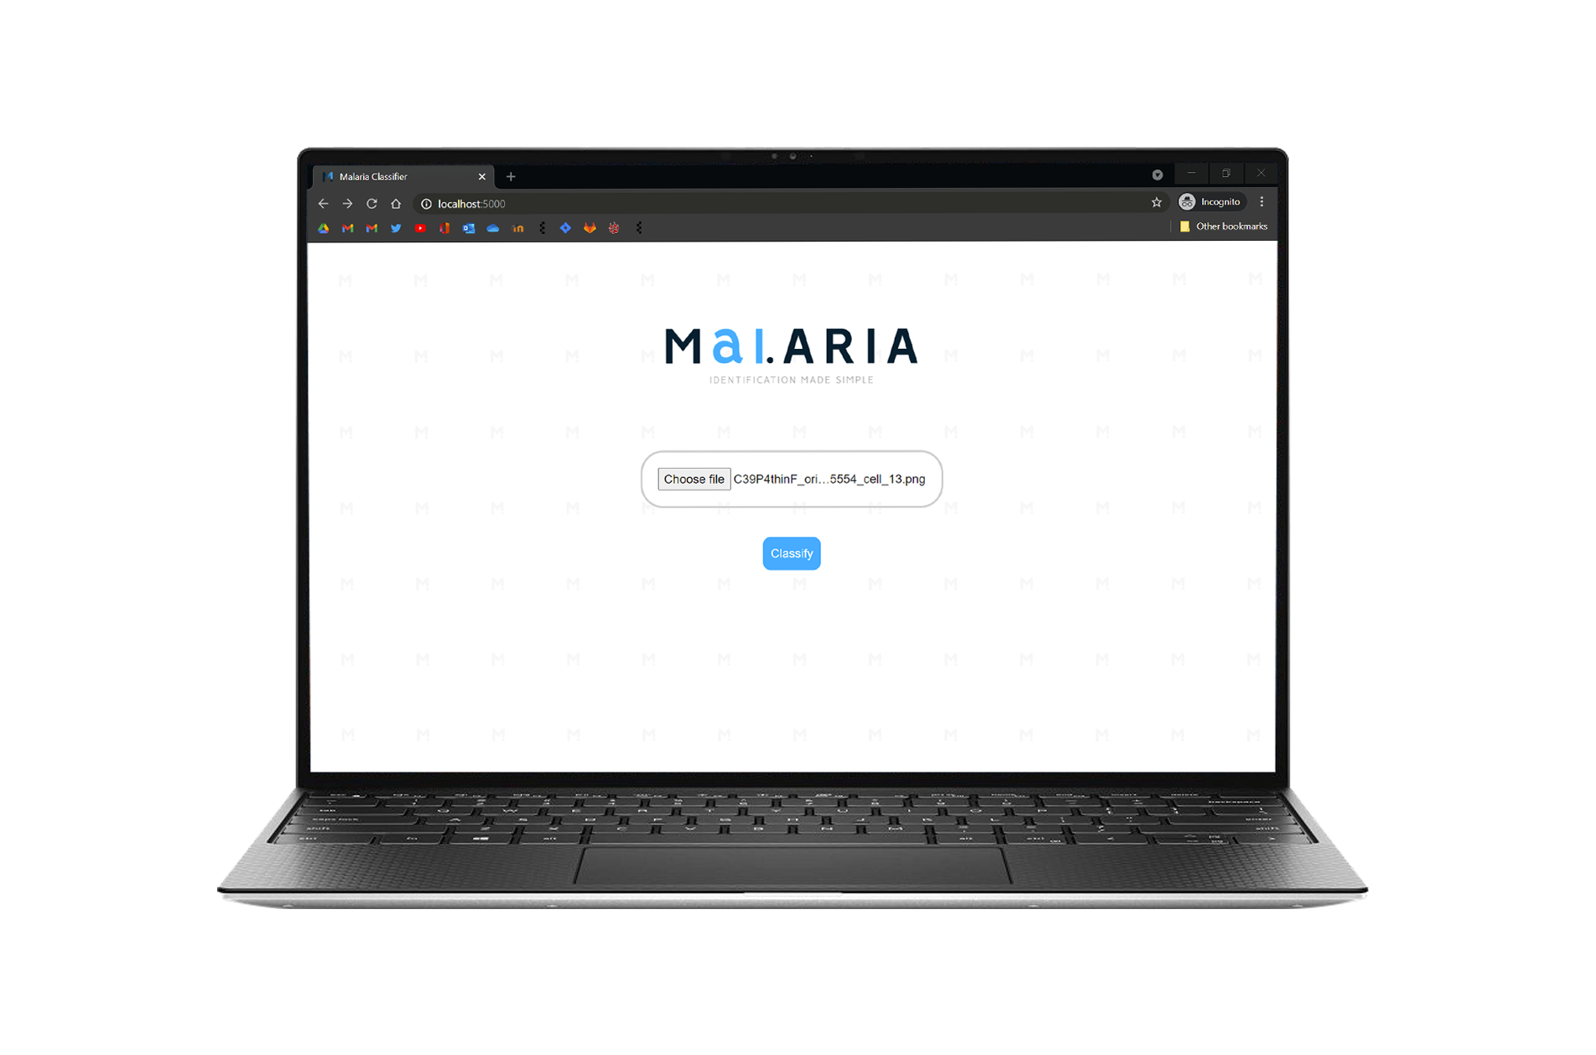
DEMO
3. The sample has been selected

Slide 14
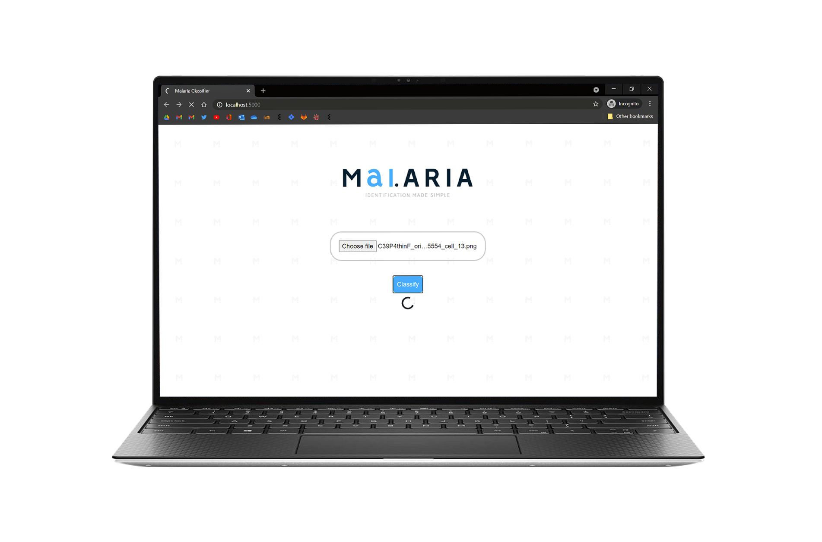
DEMO
4. The ‘classify’ button has been clicked and the sample is being classified

Slide 15
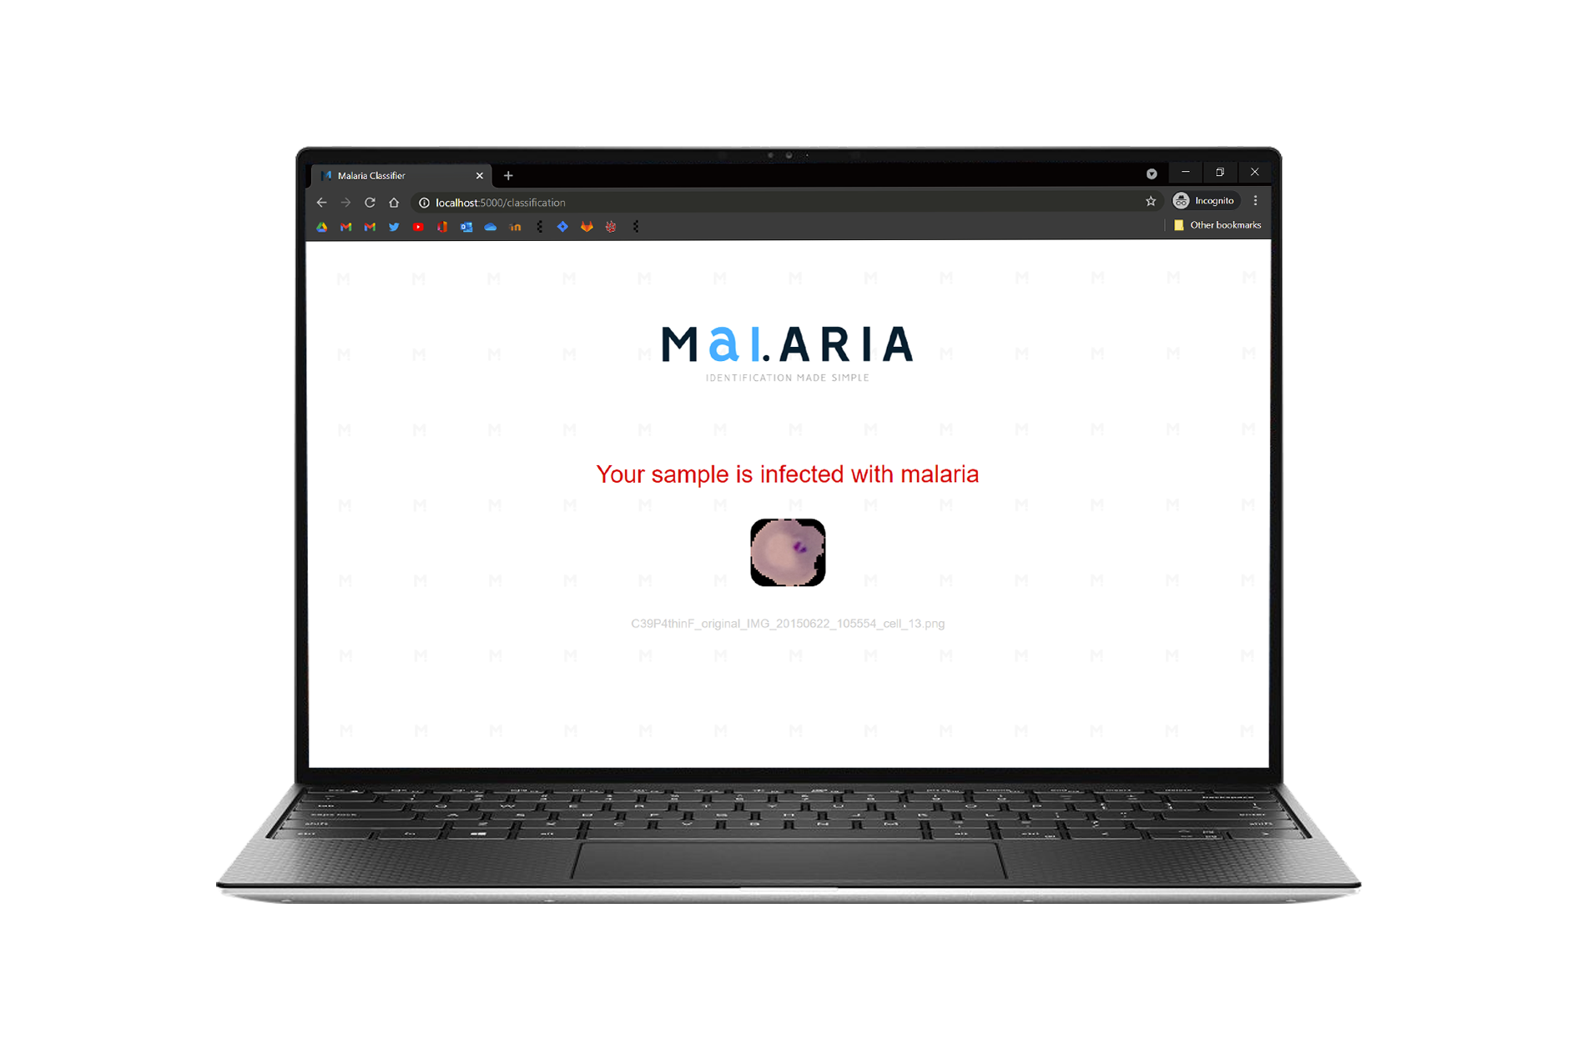
DEMO
5a. The classification output for an infected sample

Slide 16
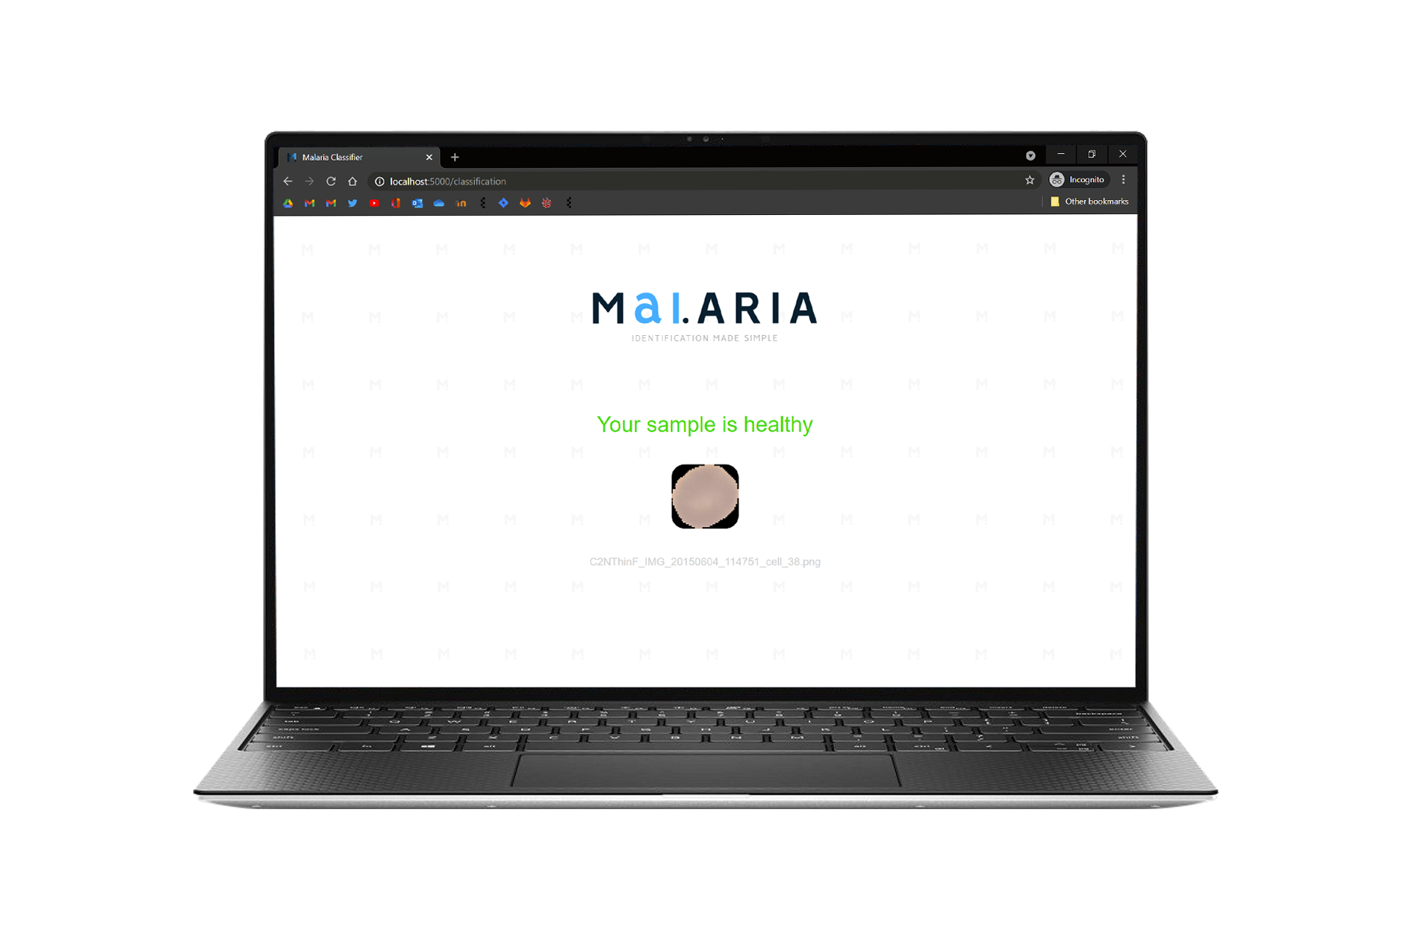
DEMO
5b. The classification output for a healthy sample

Slide 17

DID I MEET MY AIMS & OBJECTIVES?
Design and implement a classification tool that identifies malaria parasites in pre-segmented red blood cells
Design a Convolutional Neural Network using reputable Python ML libraries
Through iterative testing, improve CNN model performance (accuracy) using ML techniques
When testing the application on unseen samples, the model should achieve a higher test accuracy than the RDT’s diagnostic accuracy of 79% (among under 5’s in Nigeria, 2015 [4])
Create a classification tool that is accessible via almost any device, enabling its use in less developed counties
The application should be simplistic to allow easy use for individuals with limited medical knowledge

Slide 18
INTERIM → “TIMELINE OF FUTURE OBJECTIVES”
Improve my convolutional neural network model through research and structured testing (e.g. add colour) 8/2/21 | Implement bootstrap into my website to improve usability across all devices 22/2/21 | Improve the visual styling of the user interface 8/3/21 | Slack for any issues encountered before the submissions 17/3/21
Now
17/3/21 – Open Day Submissions

Slide 19
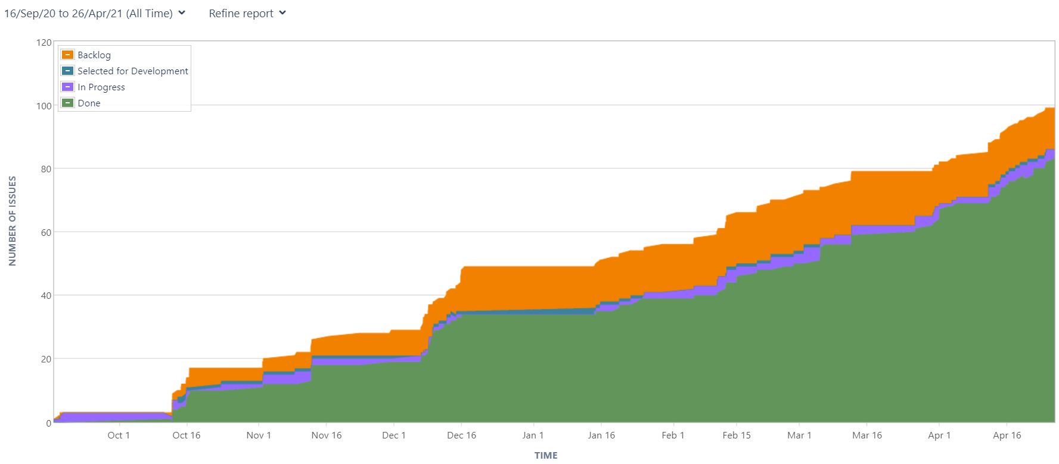
USE OF JIRA
Consistent use of Jira
Use of tasks and sub-tasks to add detail
Comments to document updates/plan future tasks
A cumulative flow diagram of issues from Jira (25/4/2021)

Slide 20
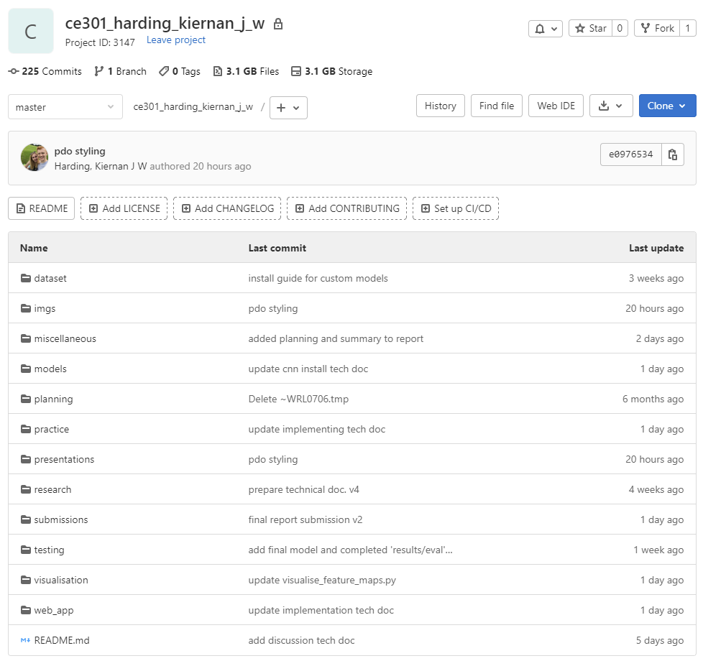
USE OF GIT
Consistent use of Git
Regular commits to Git for:
Significant changes
Keep important work backed-up!
Small required alterations
Short, meaningful commit messages
Use of .md files to keep a diary of milestone achievements and each CNN model’s performance
A snapshot of my Git repository (1/5/2021)

Slide 21

MAIN ISSUES ENCOUNTERED
Installation of the required local environment – e.g. libraries such as TensorFlow
Issues with array types between libraries – Occurred whilst creating a working convolutional neural network using tutorials
Trying to save, use and classify the input image whilst designing the web application

Slide 22

HOW TO IMPROVE
Research further ML techniques to improve the model’s performance (increase accuracy)
Significantly altering the CNN architecture and more of its parameters
Investigate segmenting red blood cells from thin blood smears, allowing the whole classification process to be automated

Slide 23
THANK YOU, I HOPE YOU ENJOYED! ANY QUESTIONS?

Slide 24
REFERENCES
[1] WHO, “World Malaria Report 2020,” 30 November 2020. [Online]. Available: https://www.who.int/publications/i/item/9789240015791.
[2] WHO, “World Malaria Report 2019,” 4 December 2019. [Online]. Available: https://www.who.int/publications/i/item/9789241565721.
[3] Worldometer, “GDP per Capita,” 2017. [Online]. Available: https://www.worldometers.info/gdp/gdp-per-capita/.
[4] A. F. Fagbamigbe, “On the discriminatory and predictive accuracy of the RDT against the microscopy in the diagnosis of malaria among under-five children in Nigeria,” Malaria journal, vol. 18, no. 1, pp. 1-12, 21 February 2019.
[5] S. Saha, “A Comprehensive Guide to Convolutional Neural Networks,” 15 December 2018. [Online]. Available: https://towardsdatascience.com/a-comprehensive-guide-to-convolutional-neural-networks-the-eli5-way-3bd2b1164a53.
[6] R. Gandhi, “Build Your Own Convolution Neural Network in 5 mins,” 18 May 2018. [Online]. Available: https://towardsdatascience.com/build-your-own-convolution-neural-network-in-5-mins-4217c2cf964f.
[7] Stanford, “CS231n Convolutional Neural Networks for Visual Recognition,” [Online]. Available: https://cs231n.github.io/convolutional-networks/. [Accessed 1 April 2021].
[8] A. Budhiraja, “Dropout in (Deep) Machine learning,” 15 December 2016. [Online]. Available: https://medium.com/@amarbudhiraja/https-medium-com-amarbudhiraja-learning-less-to-learn-better-dropout-in-deep-machine-learning-74334da4bfc5.
[9] E. Dauria, “Accuracy, Recall & Precision,” 8 December 2019. [Online]. Available: https://medium.com/@erika.dauria/accuracy-recall-precision-80a5b6cbd28d.

